Slide 1
Electricity Consumption Prediction

Slide 2
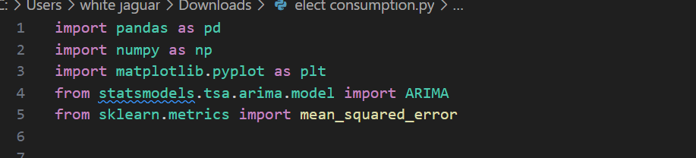
pandas (pd): Used for data manipulation and analysis.numpy (np): Provides support for large, multi-dimensional arrays and matrices, and mathematical functions.matplotlib.pyplot (plt): Used for creating static, animated, and interactive visualizations.statsmodels.tsa.arima.model.ARIMA: Class from statsmodels library used to build ARIMA models for time series analysis.sklearn.metrics.mean_squared_error: Function from sklearn library used to calculate mean squared error for model evaluation.

Slide 3
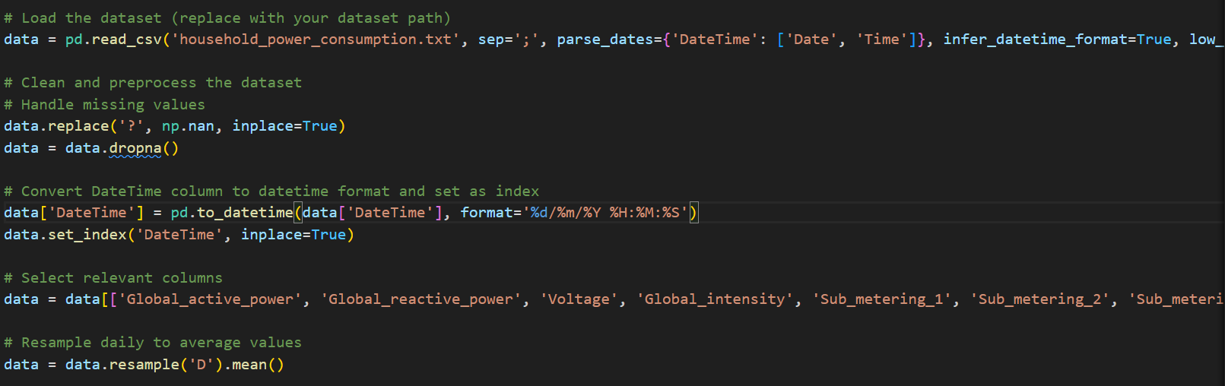
pd.read_csv(): Loads data from a CSV file into a pandas DataFrame, specifying separators and parsing dates to combine 'Date' and 'Time' into a datetime column.Data Cleaning: Replaces '?' with np.nan (missing values) and drops rows with missing values.Datetime Conversion: Converts the 'DateTime' column to datetime format and sets it as the index of the DataFrame for time series analysis.Column Selection: Selects relevant columns (Global_active_power, Global_reactive_power, etc.) for analysis.Resampling: Aggregates data to daily frequency ('D') and computes the mean for each day.

Slide 4
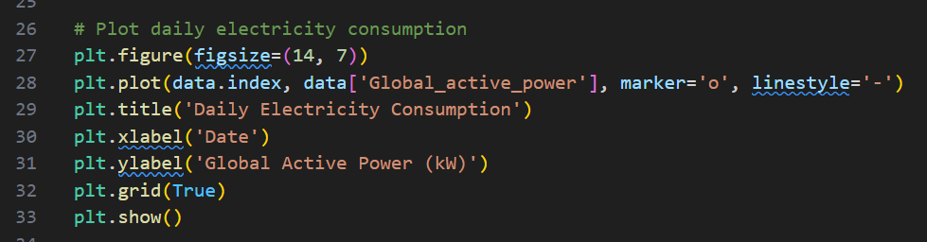
plt.figure(figsize=(14, 7)): Creates a new figure with a specific size (14 inches wide by 7 inches tall) for plotting.plt.plot(): Plots the 'Global_active_power' against dates.Plot Customization: Adds title, labels for x and y axes, enables grid lines, and displays the plot.

Slide 5
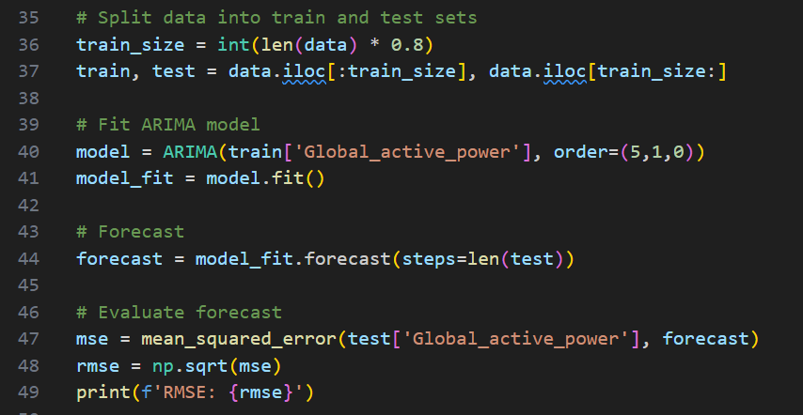
Time Series Forecasting with ARIMA

Slide 6
Train-Test Split: Splits the data into training (80%) and testing (20%) sets based on the length of the data.ARIMA Model Fitting: Creates an ARIMA model with parameters (p=5, d=1, q=0) and fits it to the training data (train['Global_active_power']).Forecasting: Generates forecasts (forecast) for the length of the test set using the fitted ARIMA model.Model Evaluation: Calculates Root Mean Squared Error (RMSE) between the actual values (test['Global_active_power']) and the forecasted values (forecast).

Slide 7
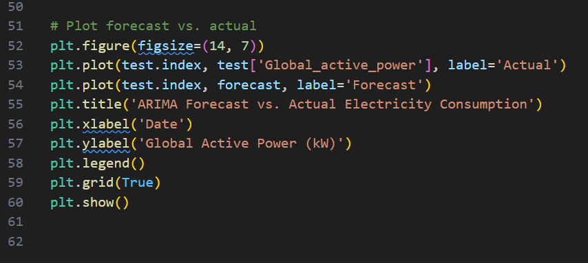
Plotting: Plots the actual ('Actual') and forecasted ('Forecast') values of 'Global_active_power' against dates.Plot Customization: Adds title, labels for x and y axes, legend, enables grid lines, and displays the plot.

Slide 8
Thankyou

